Slide 1

Introduction to quantum networks
MCH2022, 23 July 2022
Wojciech Kozlowski

Slide 2
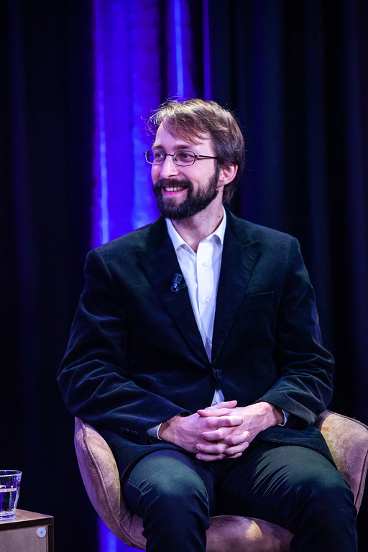
Welcome & introduction
MSci in Theoretical Quantum Physics
PhD in Atomic and Laser Physics
Worked for 2 years in the network protocols team at Metaswitch
Joined QuTech / TU Delft in 2019 in Prof. Stephanie Wehner’s group as a postdoc
As of 2020 I co-chair the Quantum Internet Research Group (QIRG) at the IRTF
As of 2021 my role at QuTech / TU Delft changed to “Quantum Network Engineer”

Slide 3
What is a quantum network good for?

Slide 4
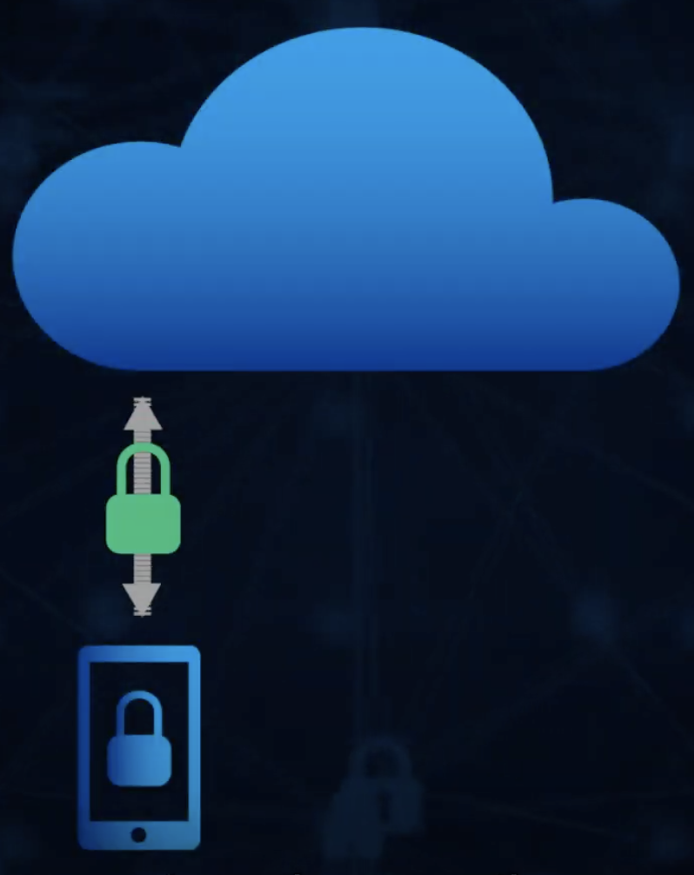


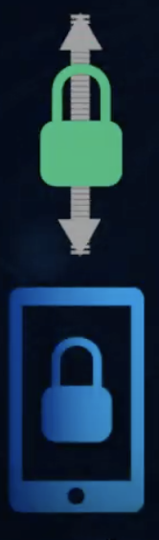
Quantum Network Applications
Quantum cryptography
Distributed/cloud quantum computing
Quantum-enhanced sensors
Quantum key distribution (QKD)
Quantum byzantine agreement
Leader election
Client-server quantum computing
Blind quantum computing
Distributed quantum computing
Interferometry
Telescopes
Clocks

Slide 5
Quantum Network Applications
Quantum Computing integrated with the Quantum Internet
Quantum Functionality
Global Quantum Internet
Goals for 2030
Quantum Memory
Cluster Quantum Computing
Quantum Entanglement
Blind Quantum Computing in a Quantum Cloud
Trials with industry
Multipoint-to-Multipoint Qubit Transmission
Quantum Key Distribution (with end-to-end security)
for Encryption, Authentication, etc. etc.
Other applications: Password identification, position verification, and more
Point-to-Point Qubit Transmission
Quantum Key Distribution (QKD) (without end-to-end security)
for encryption, Authentication, etc.

Slide 6
Quantum Bits

Slide 7
Quantum Bits
A classical bit is a binary digit representing one of two values: {0, 1}
A classical bit is either in state “0” or in state “1”
A READ operation on a bit in state “0” results in a read-out of 0
Subsequent READ operations on that bit will also result in a read-out of 0
A READ operation on a bit in state “1” results in a read-out of 1
Subsequent READ operations on that bit will also result in a read-out of 0

Slide 8

Quantum Bits
A quantum bit (qubit) is the quantum equivalent of a classical bit representing one of two values: {$|\left.0\right\rangle ,|\left.1\right\rangle$}, or their superposition
$$|\left.φ\right\rangle =α|\left.0\right\rangle +β|\left.1\right\rangle$$
A READ operation on a qubit in state $|\left.φ\right\rangle$ results in a read-out of 0 with probability ${\left|α\right|}^{2}$
The READ operation causes the state to “collapse” into a state representing the read-out, in this case $|\left.φ′\right\rangle =|\left.0\right\rangle$
Subsequent READ operations on that qubit will result in a read-out of 0 with probability 1

Slide 9

Quantum Bits
A quantum bit (qubit) is the quantum equivalent of a classical bit representing one of two values: {$|\left.0\right\rangle ,|\left.1\right\rangle$}, or their superposition
$$|\left.φ\right\rangle =α|\left.0\right\rangle +β|\left.1\right\rangle$$
A READ operation on a qubit in state $|\left.φ\right\rangle$ results in a read-out of 1 with probability ${\left|β\right|}^{2}$
The READ operation causes the state to “collapse” into a state representing the read-out, in this case $|\left.φ′\right\rangle =|\left.1\right\rangle$
Subsequent READ operations on that qubit will result in a read-out of 1 with probability 1

Slide 10

Quantum Bits
Superposition generalises to multiple qubits (note that $|\left.00\right\rangle =|\left.0\right\rangle |\left.0\right\rangle$)
$$\left|\left.φ\right\rangle =α\right|\left.00\right\rangle +β\left|\left.01\right\rangle +γ\right|\left.10\right\rangle +δ|\left.11\right\rangle$$
A READ operation on the first qubit of state $|\left.φ\right\rangle$ results in a read-out of 0 with probability ${\left|α\right|}^{2}+{\left|β\right|}^{2}$
The READ operation causes the state to “collapse” into a state representing the read-out, in this case
$$|\left.φ′\right\rangle =α′|\left.00\right\rangle +β^{′}|\left.01\right\rangle$$
Subsequent READ operations on the same qubit will result in a read-out of 0 with probability 0

Slide 11

Quantum Bits
From the previous slide
$$\left|\left.φ′\right\rangle =α′\right|\left.00\right\rangle +β′|\left.01\right\rangle$$
A READ operation on the second qubit of state $|\left.φ′\right\rangle$ results in a read-out of 0 with probability ${\left|α′\right|}^{2}$
The READ operation causes the state to “collapse” into a state representing the read-out, in this case
$$|\left.φ′′\right\rangle =|\left.00\right\rangle$$
Subsequent READ operations on the same qubit will result in a read-out of 0 with probability 0

Slide 12



Quantum Bits
Pauli X gate
$|\left.0\right\rangle \underset{→}{X}|\left.1\right\rangle$
$|\left.1\right\rangle \underset{→}{X}|\left.0\right\rangle$
Pauli Y gate
$|\left.0\right\rangle \underset{→}{Y}−i|\left.1\right\rangle$
$|\left.1\right\rangle \underset{→}{Y}i|\left.0\right\rangle$
Pauli Z gate
$|\left.0\right\rangle \underset{→}{Z}|\left.0\right\rangle$
$|\left.1\right\rangle \underset{→}{Z}−|\left.1\right\rangle$
Hadamard gate
$|\left.0\right\rangle \underset{→}{H}\left(|\left.0\right\rangle +|\left.1\right\rangle \right)/\sqrt{2}$
$|\left.1\right\rangle \underset{→}{H}\left(|\left.0\right\rangle −|\left.1\right\rangle \right)/\sqrt{2}$
CNOT (CX)
$|\left.00\right\rangle \underset{→}{CNOT}|\left.00\right\rangle$
$|\left.01\right\rangle \underset{→}{CNOT}|\left.01\right\rangle$
$|\left.10\right\rangle \underset{→}{CNOT}|\left.11\right\rangle$
$|\left.11\right\rangle \underset{→}{CNOT}|\left.10\right\rangle$

Slide 13

Quantum Bits
Pauli X gate
$$|\left.φ\right\rangle =α|\left.0\right\rangle +β|\left.1\right\rangle \underset{→}{X}β|\left.0\right\rangle +α|\left.1\right\rangle$$
Pauli Y gate
$$|\left.φ\right\rangle =α|\left.0\right\rangle +β|\left.1\right\rangle \underset{→}{Y}i\left(β|\left.0\right\rangle −α|\left.1\right\rangle \right)$$
Pauli Z gate
$$|\left.φ\right\rangle =α|\left.0\right\rangle +β|\left.1\right\rangle \underset{→}{Z}α|\left.0\right\rangle −β|\left.1\right\rangle$$

Slide 14

Quantum Bits
Two qubits
$$|\left.φ\right\rangle =|\left.00\right\rangle$$
Apply an H gate on the first qubit
$|\left.φ\right\rangle =|\left.00\right\rangle =|\left.0\right\rangle |\left.0\right\rangle \underset{→}{H_{1}}\frac{1}{\sqrt{2}}\left(|\left.0\right\rangle +|\left.1\right\rangle \right)|\left.0\right\rangle$ $=\frac{1}{\sqrt{2}}\left(|\left.00\right\rangle +|\left.10\right\rangle \right)$
Apply a CNOT gate
$$|\left.φ\right\rangle =\frac{1}{\sqrt{2}}\left(|\left.00\right\rangle +|\left.10\right\rangle \right)\underset{→}{CNOT}\frac{1}{\sqrt{2}}\left(|\left.00\right\rangle +|\left.11\right\rangle \right)$$

Slide 15

Quantum Bits
$$|\left.φ\right\rangle =\frac{1}{\sqrt{2}}\left(|\left.00\right\rangle +|\left.11\right\rangle \right)$$
Both qubits are equally likely to read-out 0 or 1 on a READ operation
Before the READ we do not know which one we will get
After the READ operation on the first qubit we will have a read-out value
This will “collapse” the state into a new state consistent with the read-out
In the state $|\left.φ\right\rangle$ this means either $|\left.00\right\rangle$ or $|\left.11\right\rangle$

Slide 16
Quantum Bits
The other qubit is guaranteed to have the same value even though they were both indeterminate initially and we only measured one of the qubits
Distance does not matter – a READ on one qubit affects the overall state regardless of where the other qubit is located
Stronger-than-classical correlations
Quantum networking “secret sauce”

Slide 17
Quantum Entanglement

Slide 18

Quantum Entanglement
In our everyday “classical” world, we can describe the state of physically separate objects independently of each other – we can measure all their properties without having to know the state of the other object
Quantum entangled objects (qubits) can no longer be described independently of each other – their individual properties depend on the state of the entire entangled system – regardless of distance

Slide 19
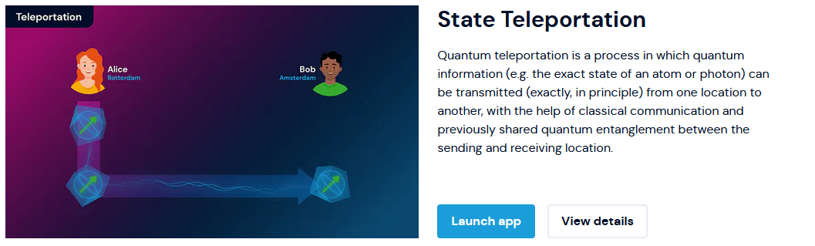
Quantum Entanglement

Slide 20

Quantum Entanglement
Alice
2-bit measurement outcome
QUANTUM DATA
QUANTUM DATA
Bob

Slide 21
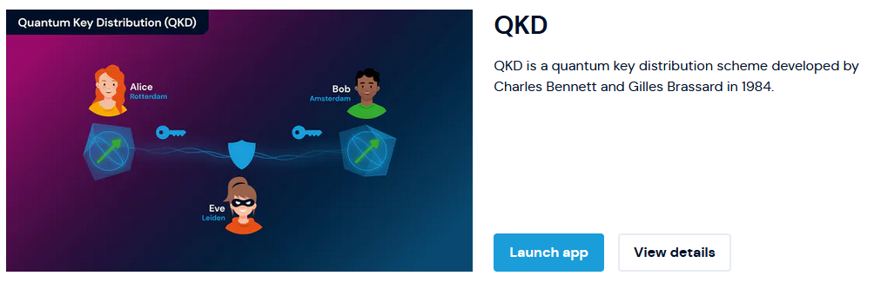
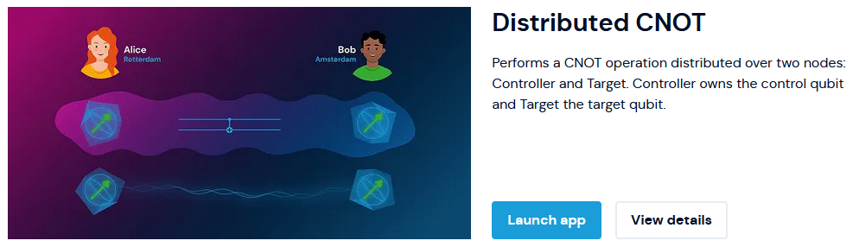
Quantum Entanglement

Slide 22


Quantum Entanglement
quantum
network

Slide 23
Quantum Key Distribution
Quantum Key Distribution (QKD) generates a pair of identical keys at two remote nodes for use in a classical symmetric encryption schemes.
Only key generation is quantum – encryption/decryption remains a purely classical task.
QKD makes no computational assumptions about the adversary – the protocol is provably secure.
The security proofs in the presence of losses are much more complicated than what I will demonstrate, but they are indeed mathematically provable (up to the implementation matching the theoretical assumptions).
The key is generated randomly from entangled qubits – it’s as if you generated your secret key by flipping two coins at the two remote nodes and they always fell on the same side at each end with each throw.

Slide 24

Stage 1: Receiving
Alice and Bob share multiple entangled pairs of qubits with each other.
$$|\left.φ\right\rangle =\frac{1}{\sqrt{2}}\left(|\left.00\right\rangle +|\left.11\right\rangle \right)$$
Both, independently of each other, and without telling each other, randomly choose whether to apply an H gate
$$|\left.φ\right\rangle =\frac{1}{\sqrt{2}}\left(|\left.00\right\rangle +|\left.11\right\rangle \right)\underset{→}{H_{1}}\frac{1}{2}\left(|\left.00\right\rangle +|\left.01\right\rangle +|\left.10\right\rangle −|\left.11\right\rangle \right)\underset{→}{H_{2}}\frac{1}{\sqrt{2}}\left(|\left.00\right\rangle +|\left.11\right\rangle \right)$$
Alice and Bob READ (i.e. measure) their qubits and keep the result secret – it will be used to build the secret key.
 | A | B | A | B | A | B | A | B | A | B | A | B | A | B | A | B | A | B | A | B | A | B | A | B | A | B | A | B | A | B | A | B
Apply H | Y | - | Y | Y | - | Y | - | - | Y | Y | - | Y | - | - | Y | - | - | Y | Y | Y | - | - | Y | - | - | - | - | Y | Y | - | Y | Y
Bits | 0 | 1 | 1 | 1 | 1 | 1 | 1 | 1 | 0 | 0 | 1 | 0 | 1 | 1 | 0 | 0 | 0 | 1 | 0 | 0 | 0 | 0 | 1 | 0 | 1 | 1 | 1 | 1 | 0 | 0 | 0 | 0

Slide 25
Stage 1: Receiving
 | A | B | A | B | A | B | A | B | A | B | A | B | A | B | A | B | A | B | A | B | A | B | A | B | A | B | A | B | A | B | A | B
Apply H | Y | - | Y | Y | - | Y | - | - | Y | Y | - | Y | - | - | Y | - | - | Y | Y | Y | - | - | Y | - | - | - | - | Y | Y | - | Y | Y
Bits | 0 | 1 | 1 | 1 | 1 | 1 | 1 | 1 | 0 | 0 | 1 | 0 | 1 | 1 | 0 | 0 | 0 | 1 | 0 | 0 | 0 | 0 | 1 | 0 | 1 | 1 | 1 | 1 | 0 | 0 | 0 | 0
The key is not yet secure as there could be an eavesdropper.
However, the eavesdropper does not know what decisions Alice and Bob are making and therefore, must guess.
By guessing and then measuring, the eavesdropper “collapses” the state, i.e. irreversibly disturbs it.
This disturbance will reveal itself later when Alice and Bob will be testing for errors.

Slide 26
Stage 2: Sifting
Alice and Bob publicly announce which times they applied the H gate and which times they did not.
Alice and Bob discard all bits that resulted from a readout when their decisions did not match – these bits will not be correlated with each other.
In the absence of an eavesdropper all the remaining bits will be correlated, i.e. identical.
 | A | B | A | B | A | B | A | B | A | B | A | B | A | B | A | B | A | B | A | B | A | B | A | B | A | B | A | B | A | B | A | B
Apply H | Y | - | Y | Y | - | Y | - | - | Y | Y | - | Y | - | - | Y | - | - | Y | Y | Y | - | - | Y | - | - | - | - | Y | Y | - | Y | Y
Bits | 0 | 1 | 1 | 1 | 1 | 1 | 1 | 1 | 0 | 0 | 1 | 0 | 1 | 1 | 0 | 0 | 0 | 1 | 0 | 0 | 0 | 0 | 1 | 0 | 1 | 1 | 1 | 1 | 0 | 0 | 0 | 0
Sifting |  |  | Y |  |  |  | Y |  | Y |  |  |  | Y |  |  |  |  |  | Y |  | Y |  |  |  | Y |  |  |  |  |  | Y

Slide 27
Stage 3: Security
To detect an eavesdropper, Alice and Bob compare a subset of the remaining bits and check if they match.
If no eavesdropper was present they should always match perfectly.
If an eavesdropper was present, 25% will not match (50% time eavesdropper guesses incorrect basis, followed by 50% chance the disturbed bit ends up being “correct”)
If all the bits match, Alice and Bob use the remaining bits as their symmetric key. They will all be identical.
If some bits do not match, Alice and Bob discard the key as insecure.
 | A | B | A | B | A | B | A | B | A | B | A | B | A | B | A | B | A | B | A | B | A | B | A | B | A | B | A | B | A | B | A | B
Apply H | Y | - | Y | Y | - | Y | - | - | Y | Y | - | Y | - | - | Y | - | - | Y | Y | Y | - | - | Y | - | - | - | - | Y | Y | - | Y | Y
Bits | 0 | 1 | 1 | 1 | 1 | 1 | 1 | 1 | 0 | 0 | 1 | 0 | 1 | 1 | 0 | 0 | 0 | 1 | 0 | 0 | 0 | 0 | 1 | 0 | 1 | 1 | 1 | 1 | 0 | 0 | 0 | 0
Sifting |  |  | Y |  |  |  | Y |  | Y |  |  |  | Y |  |  |  |  |  | Y |  | Y |  |  |  | Y |  |  |  |  |  | Y
Compare |  |  | Y |  |  |  | - |  | Y |  |  |  | - |  |  |  |  |  | Y |  | Y |  |  |  | - |  |  |  |  |  | -

Slide 28
Stage 3: Security
 | A | B | A | B | A | B | A | B | A | B | A | B | A | B | A | B | A | B | A | B | A | B | A | B | A | B | A | B | A | B | A | B
Apply H | Y | - | Y | Y | - | Y | - | - | Y | Y | - | Y | - | - | Y | - | - | Y | Y | Y | - | - | Y | - | - | - | - | Y | Y | - | Y | Y
Bits | 0 | 1 | 1 | 1 | 1 | 1 | 1 | 1 | 0 | 0 | 1 | 0 | 1 | 1 | 0 | 0 | 0 | 1 | 0 | 0 | 0 | 0 | 1 | 0 | 1 | 1 | 1 | 1 | 0 | 0 | 0 | 0
Sifting |  |  | Y |  |  |  | Y |  | Y |  |  |  | Y |  |  |  |  |  | Y |  | Y |  |  |  | Y |  |  |  |  |  | Y
Compare |  |  | Y |  |  |  | - |  | Y |  |  |  | - |  |  |  |  |  | Y |  | Y |  |  |  | - |  |  |  |  |  | -
Final Key |  |  |  |  |  |  | 1 |  |  |  |  |  | 1 |  |  |  |  |  |  |  |  |  |  |  | 1 |  |  |  |  |  | 0

Slide 29
Write your own QKD protocol!
Please go to for easy access to necessary links and commands to copy-paste:
https://github.com/wkozlowski-tudelft/qne-workshop-mch2022
You can then either do the rest yourself or follow me for a step-by-step implementation of QKD using the Quantum Network Explorer tools.

Slide 30

JOIN OUR COMMUNITY!
SLACK: https://bit.ly/3D6Cg4x
WEB: www.quantum-network.com
LINKEDIN: linkedin.com/company/quantum-network-explorer
TWITTER: twitter.com/qnenews
THANK YOU

Slide 31


Join our team of passionate and dedicated scientists and engineers with the ambitious goal of building a Quantum Internet!
Simulation Software Engineer – Quantum Internet
Strong and demonstrable knowledge of Python programming.
Experience in development of simulation software.
At least 2 years of professional software development experience with experience in maintaining a large code base.
Fundamental knowledge of quantum physics and an interest in quantum technology.
Excellent communication skills.

